Slide 1
Major Project : ICT-452 NeuroNova
Transforming Mental Impulses Into Intelligent Actions

Slide 2

What if your mind could control your world?
Automating Gadgets with most ease and safety measures.
SMART HOME AUTOMATION

Slide 3
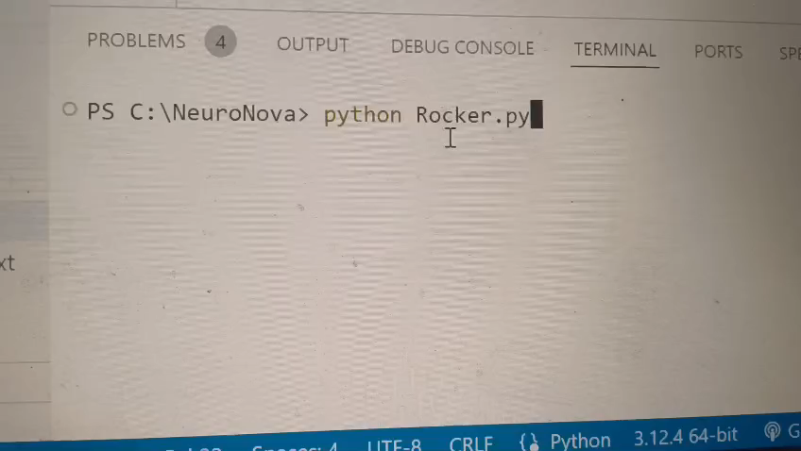
Current vs innovation Example
Current
Innovation
Dark-> Go and Turn on light manually.

Slide 4
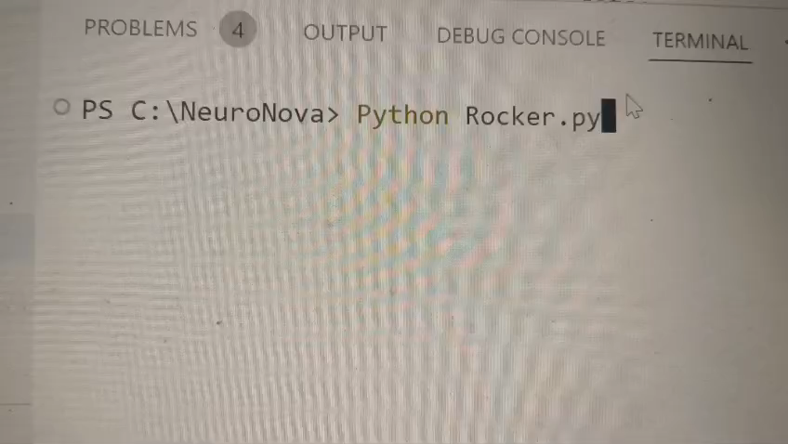
Current vs innovation Example
Current
Innovation
Feeling bored ->
Turn Exciting on Music -> Time Taking………

Slide 5
Tracing the Evolution of Brain-Computer Interfaces (BCI)
🕒 Timeline :
2002 – Teplan, M. “Fundamentals of EEG Measurement” 🧠 Established the foundation for accurate EEG signal acquisition techniques.
2009 – Mak & Wolpaw“Clinical Applications of BCIs” 🩺 Explored BCI's potential in medical rehabilitation; emphasized practical limitations.
2014 – OpenBCI Platform Launch:“Democratizing EEG” 💡 Opened the door to low-cost BCI experimentation using open hardware
2019 – NeuroTechX EEG Notebooks“Real-time EEG Analysis in Python” ⚙️ Simplified signal preprocessing and made BCI integration developer- friendly.

Slide 6
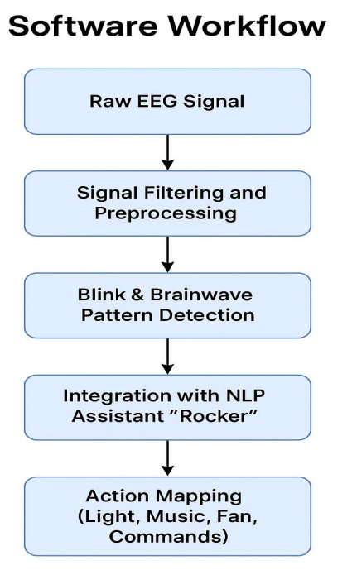
SYSTEM OVERVIEW
EEG SIGNAL
Arduino
Devices
Rocker NLP

Slide 7
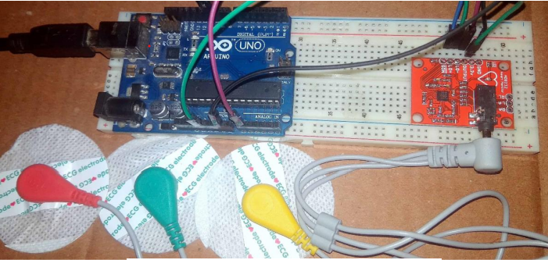
HARDWARE CIRCUIT

Slide 8
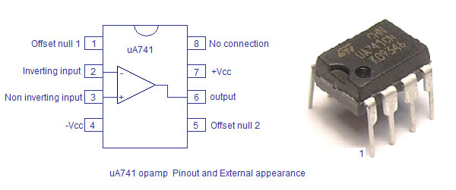
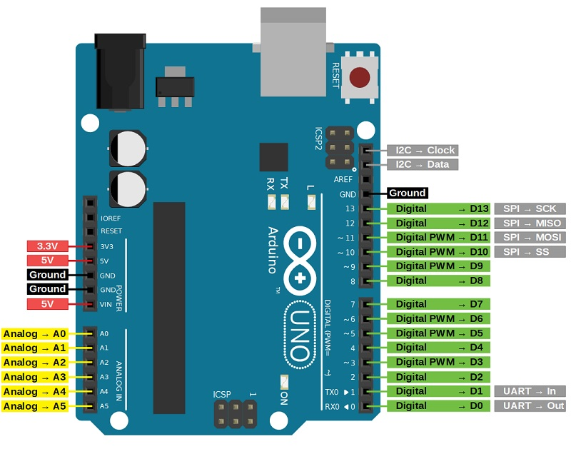
Hardware Components

Slide 9
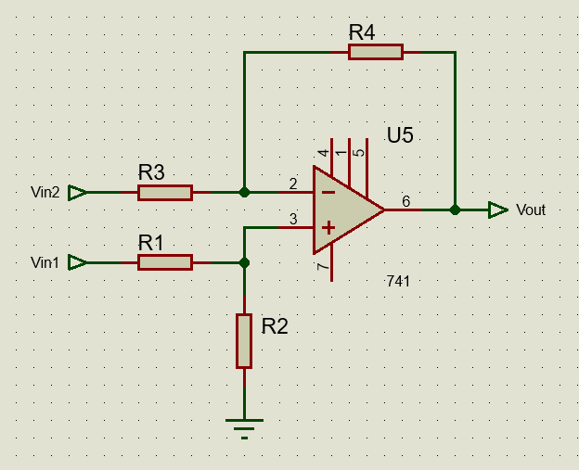
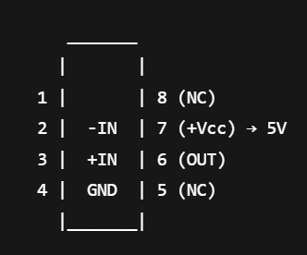
CIRCUIT DIAGRAM
IC 741
Amplifier Circuit

Slide 10
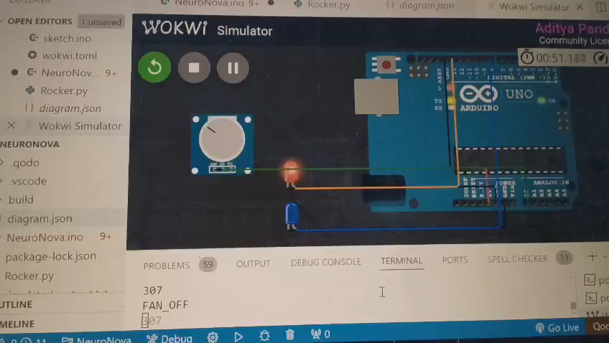
Wokwi Simulation(WOKWI+VScode)

Slide 11
MEET NLP Roker
Python Code
Reads Data Values from text file: simulated_output.txt
Searches for keywords like “BLINK2”, “MULTIBLINK” etc and perform respective actions.
Imported files like: pyttsx3, speech_recognition.

Slide 12
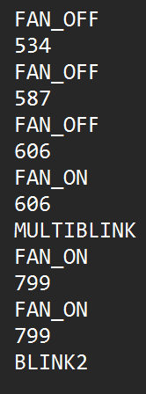
Results & Analysis
Basic emotional states (e.g., stress, calm) inferred using open EEG datasets for calibration. Integrated minimal machine learning model for adaptive thresholding.
Executed voice command interpretation within 0.6 seconds using lightweight NLP. Threshold value : 4200 based on Kaggle dataset.
ROCKER
Actions

Slide 13

THANK YOU!!

